Slide 1
第五讲 方法（method）

Slide 2
内容
The Structure of a Method
Local Variables
Flow of Control
Parameters
  Value Parameters
  Reference Parameters
  Output Parameters
  Parameter Arrays
Arrays
Method Overloading

Slide 3
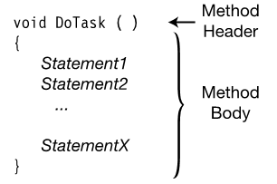
方法的结构
方法是一块具有名称的代码。
可以使用方法的名称从别的地方执行代码，也可以把数据传入方法并接收数据输出。
方法是类的函数成员，主要有两个部分，方法头和方法体

Slide 4
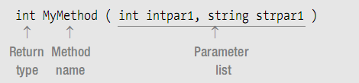
the method header

Slide 5
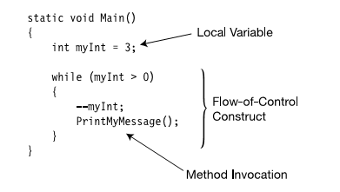
方法体内部代码的执行
方法体可包含以下项目
本地变量
控制流结构
方法调用
内嵌的块

Slide 6
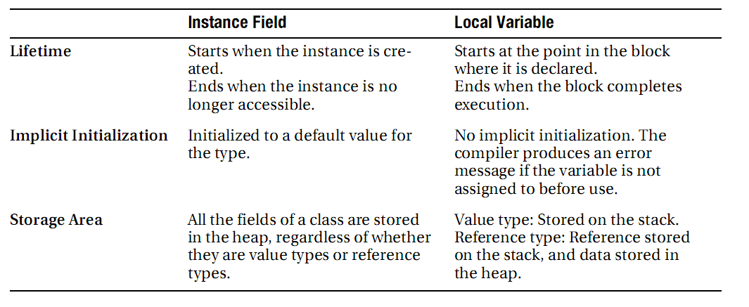
局部变量

Slide 7
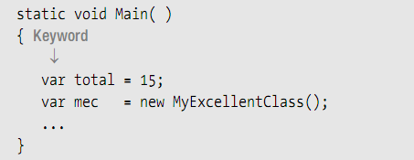
类型推断和var关键字
Type Inference and the var Keyword
“var” can only be used with local variables—not with fields

Slide 8
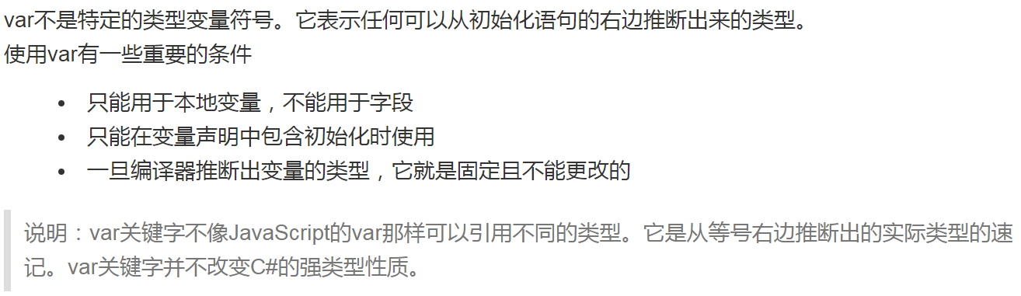

Slide 9
嵌套块中的本地变量
In C and C++ you can declare a local variable, and then within a nested block you can declare another local variable with the same name. The inner name masks the outer name while within the inner scope.
In C#, however, you cannot declare another local variable with the same name within the scope of the first name regardless of the level of nesting

Slide 10
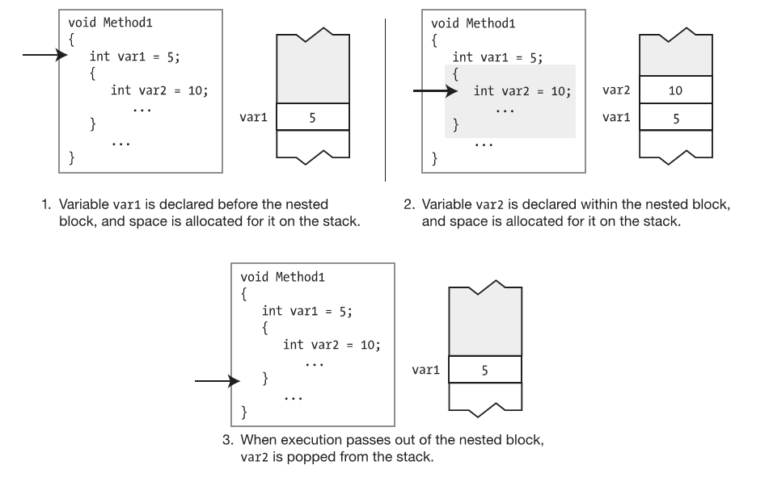

Slide 11
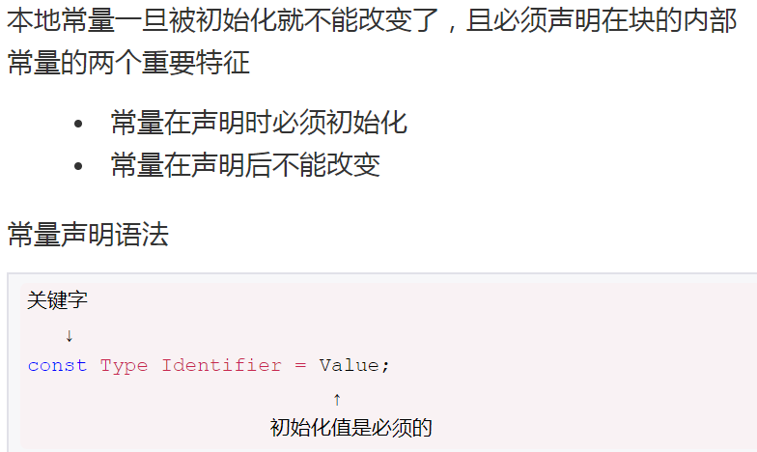
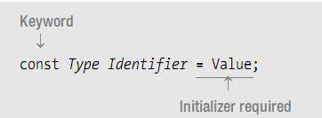
本地常量
A local constant is much like a local variable, except that once it’s initialized, its value can’t be changed.

Slide 12
控制流
Selection statements
  – if: Conditional execution of a statement
  – if...else: Conditional execution of one statement or another
  – switch: Conditional execution of one statement from a set

Slide 13
Flow of Control
Iteration statements:
  – for: Loop—testing at the top
  – while: Loop—testing at the top
  – do: Loop—testing at the bottom
  – foreach: Execute once for each member of a set

Slide 14
Flow of Control
Jump statements
  – break: Exit the current loop.
  – continue: Go to the bottom of the current loop.
  – goto: Go to a named statement.
  – return: Return execution to the calling method.

Slide 15
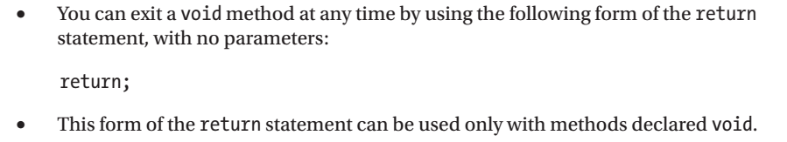
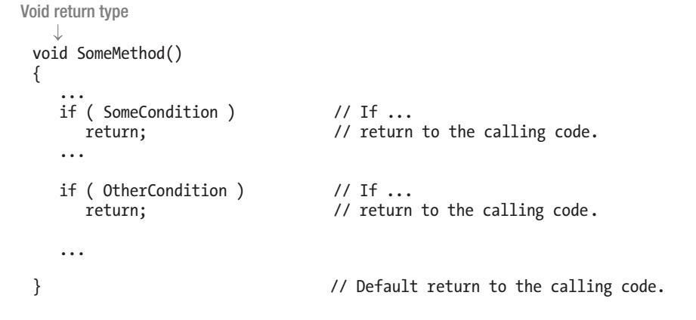
The Return Statement and Void Methods

Slide 16
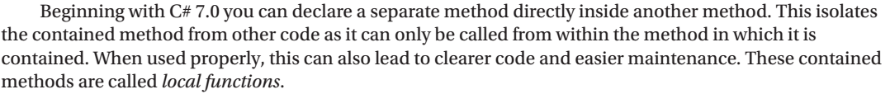
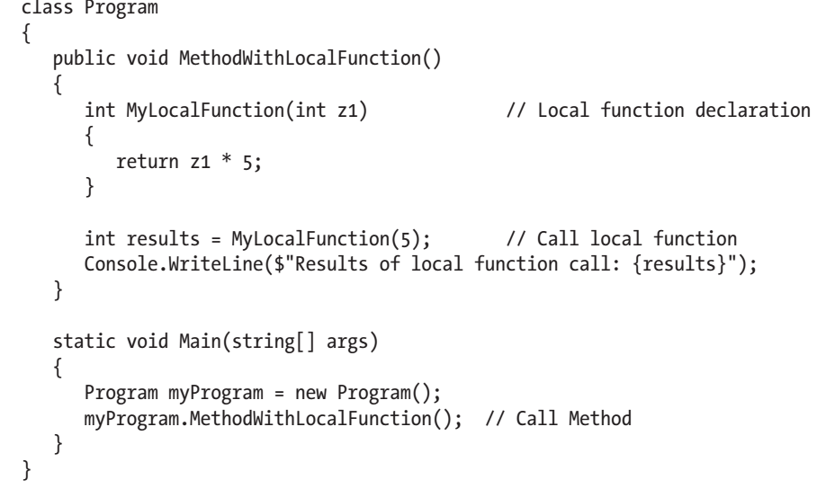
Local Functions

Slide 17
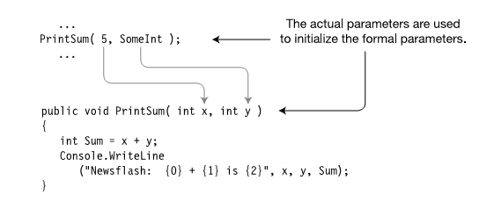
Parameters 参数
Formal Parameters
Actual Parameters

Slide 18
Parameters
Value Parameters
Reference Parameters
Output Parameters
Parameter Arrays

Slide 19
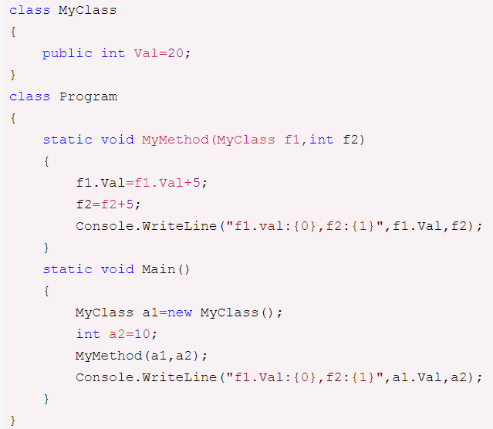
Value Parameters值参数
Demo

Slide 20
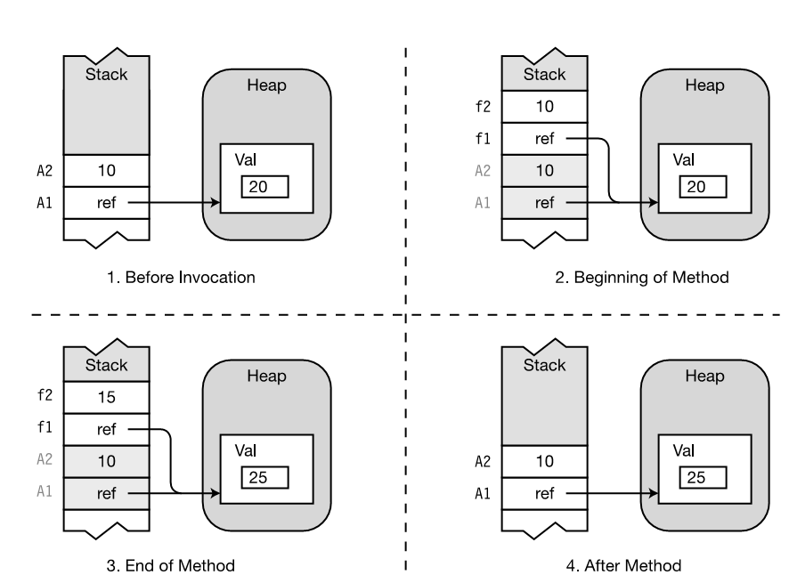

Slide 21
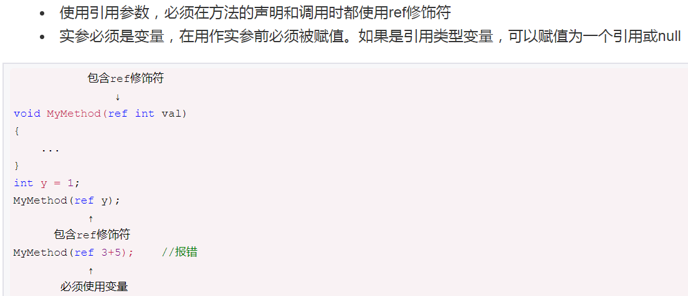
Reference Parameters引用参数
Demo

Slide 22
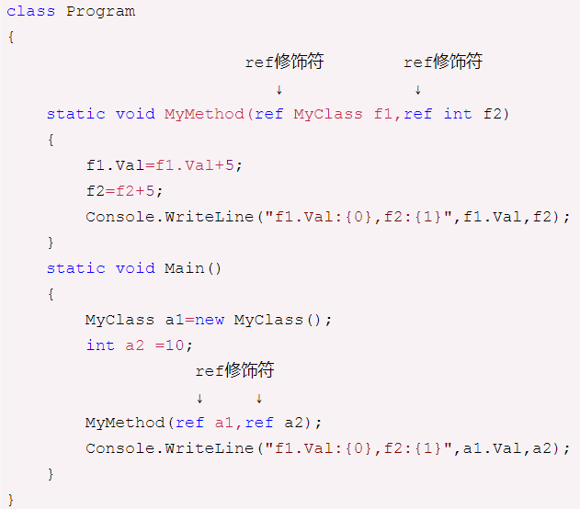

Slide 23
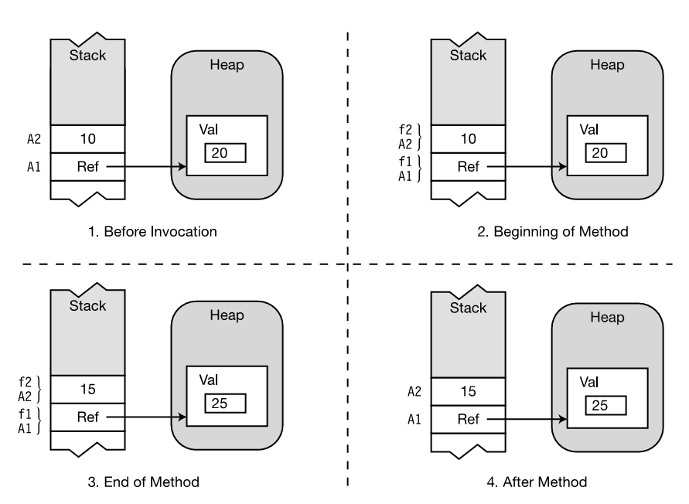

Slide 24
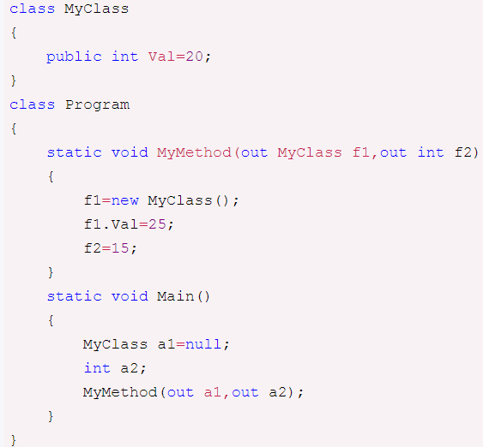
Output Parameters输出参数
Demo

Slide 25
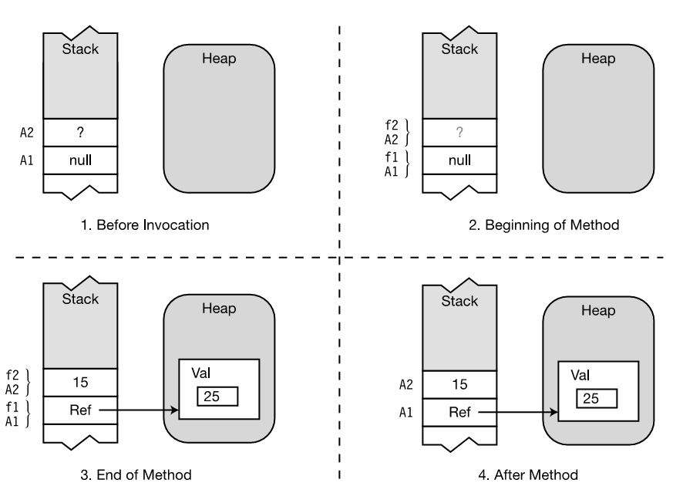

Slide 26
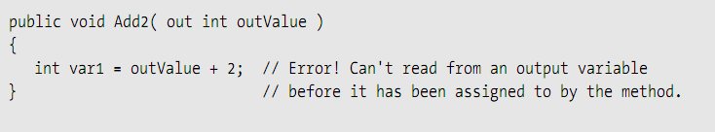
Output Parameters

Slide 27
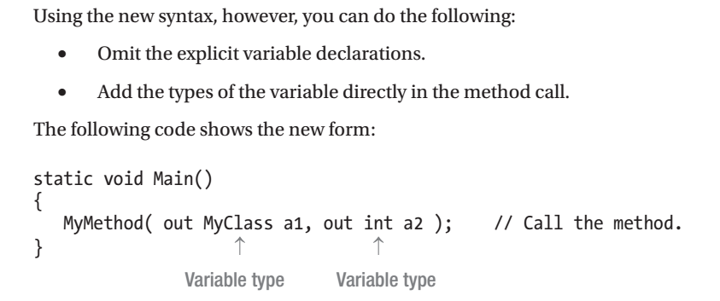
Output Parameters

Slide 28
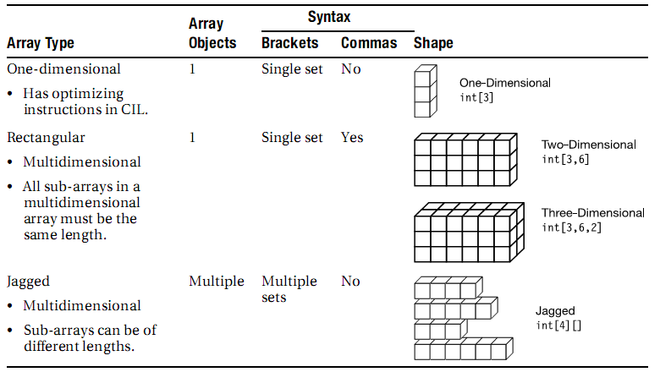
Arrays

Slide 29
Arrays
An array instance is an object whose type derives from class System.Array
Arrays are reference types

Slide 30
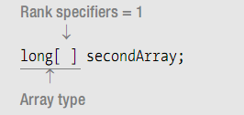
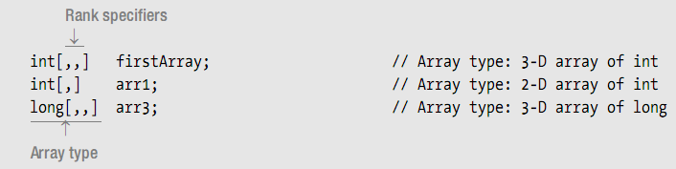
Declaring a One-Dimensional Array or a Rectangular Array

Slide 31
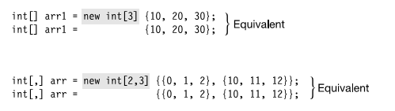
Shortcut for array declaration, creation, and initialization

Slide 32
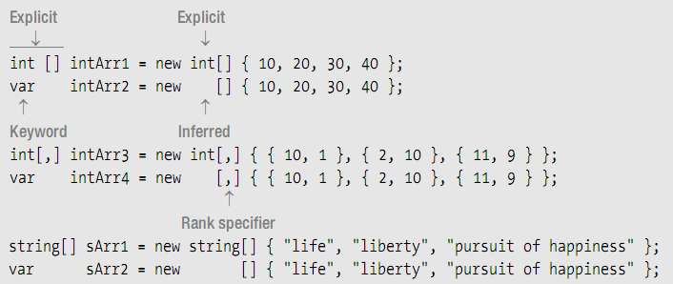
Implicitly Typed Arrays

Slide 33
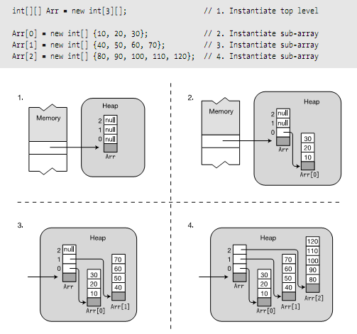
Jagged（锯齿） Arrays

Slide 34
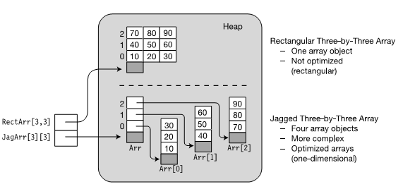
Comparing Rectangular and Jagged Arrays

Slide 35
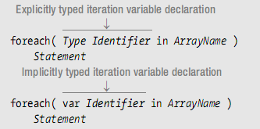
The foreach Statement

Slide 36
The foreach Statement
Demo

Slide 37
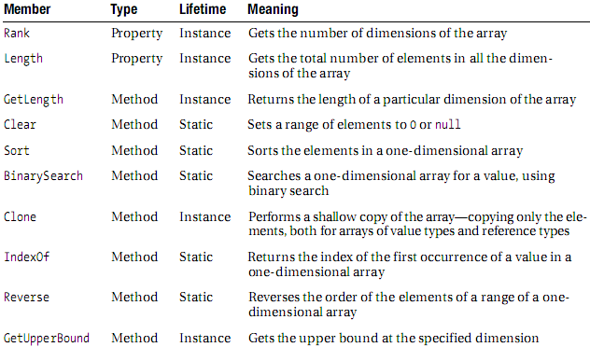
Some Useful Members Inherited by Arrays
创建一个浅表副本，具体来说就是创建一个新对象，然后将当前对象的非静态字段复制到该新对象。如果字段是值类型的，则对该字段执行逐位复制。如果字段是引用类型，则复制引用但不复制引用的对象；因此，原始对象及其复本引用同一对象。

Slide 38
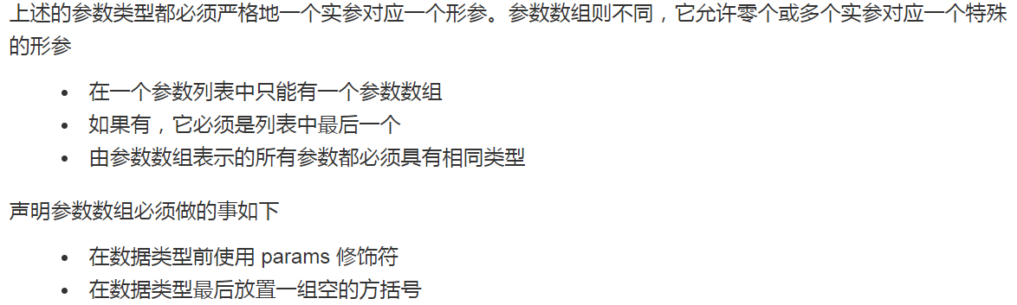
Parameter Arrays参数数组
Parameter arrays are different in that they allow zero or more actual parameters for a particular formal parameter
There can be only one parameter array in a parameter list.
If there is one, it must be the last parameter in the list.

Slide 39
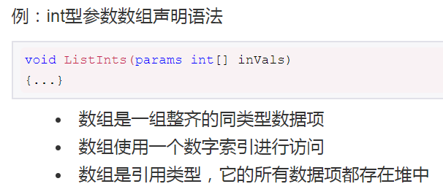

Slide 40
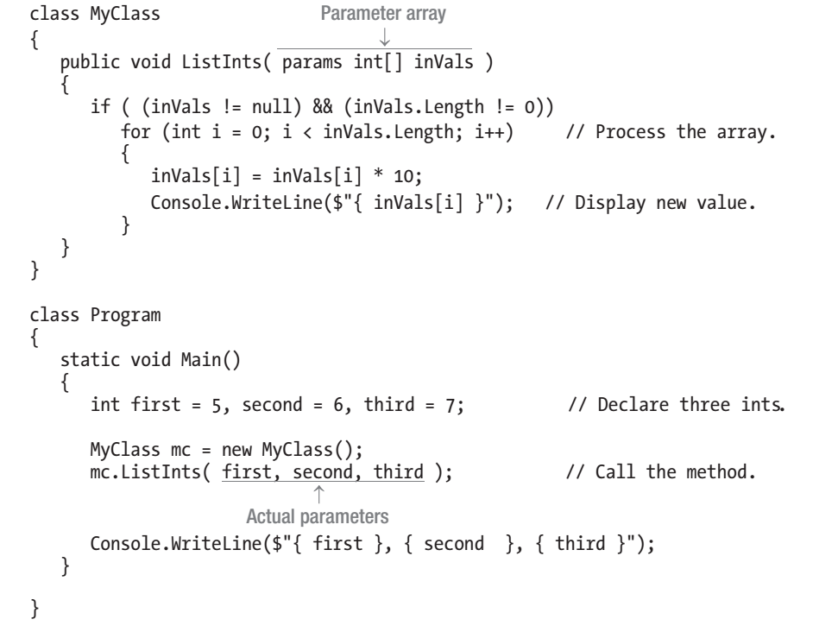
Parameter Arrays
Demo

Slide 41
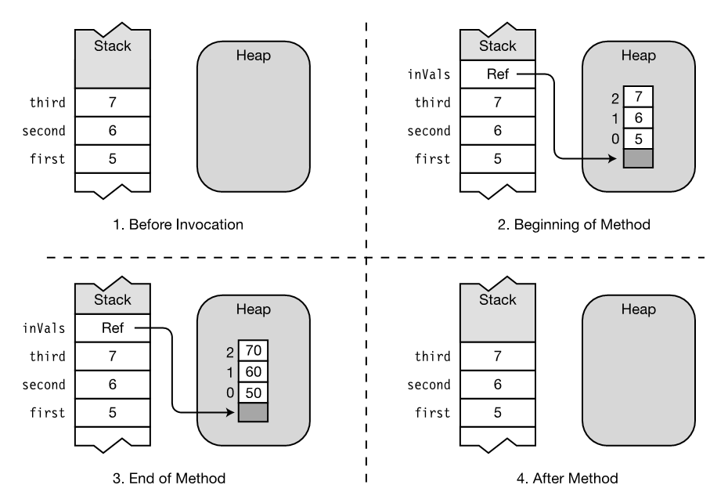

Slide 42
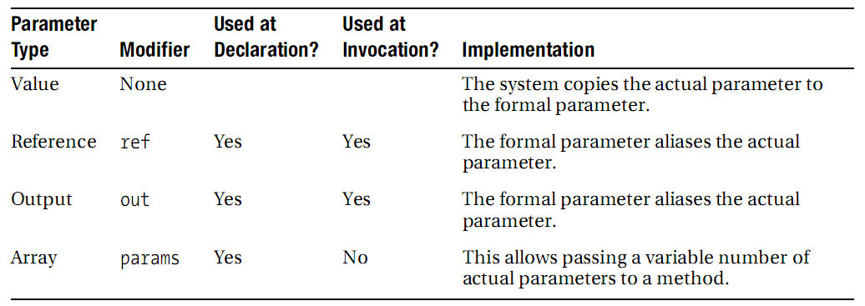
Summary of Parameter Types

Slide 43
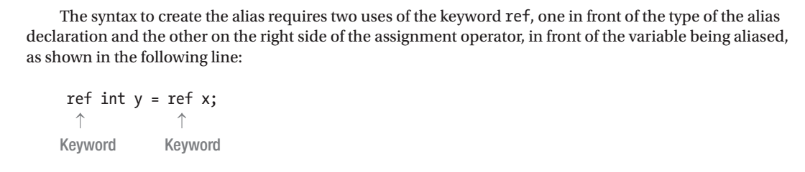
Ref Local and Ref Return

Slide 44
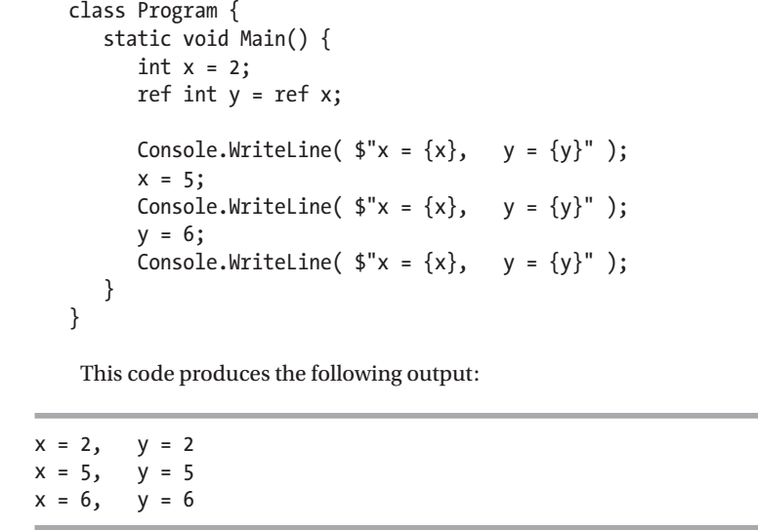

Slide 45
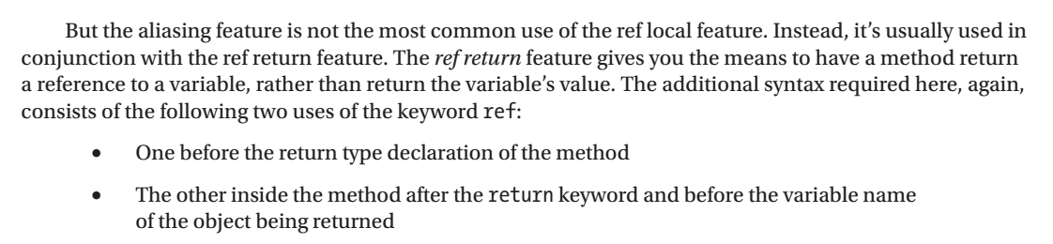

Slide 46
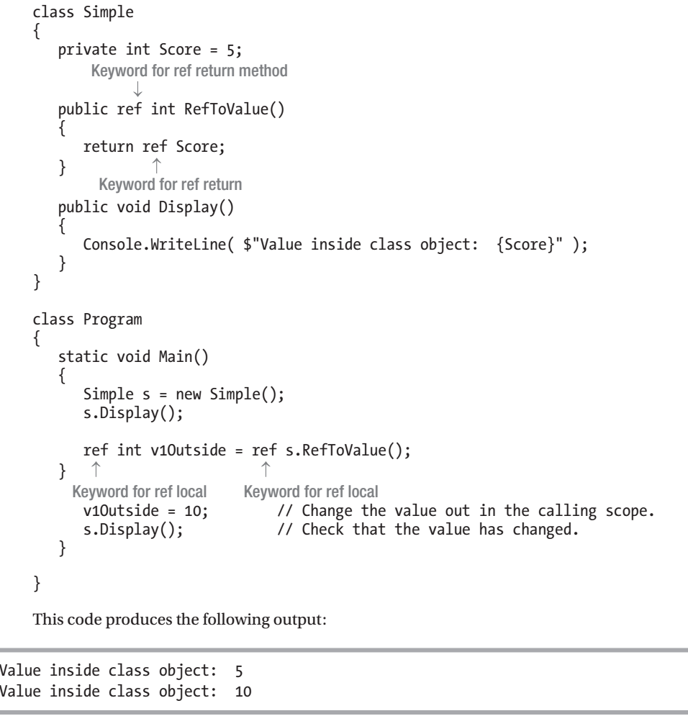

Slide 47
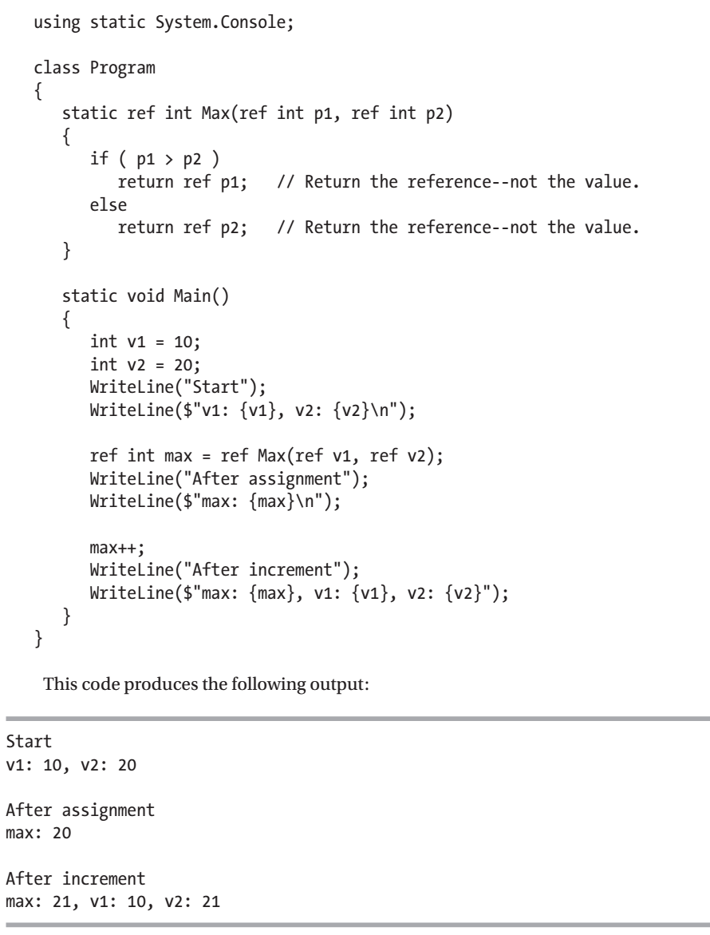

Slide 48
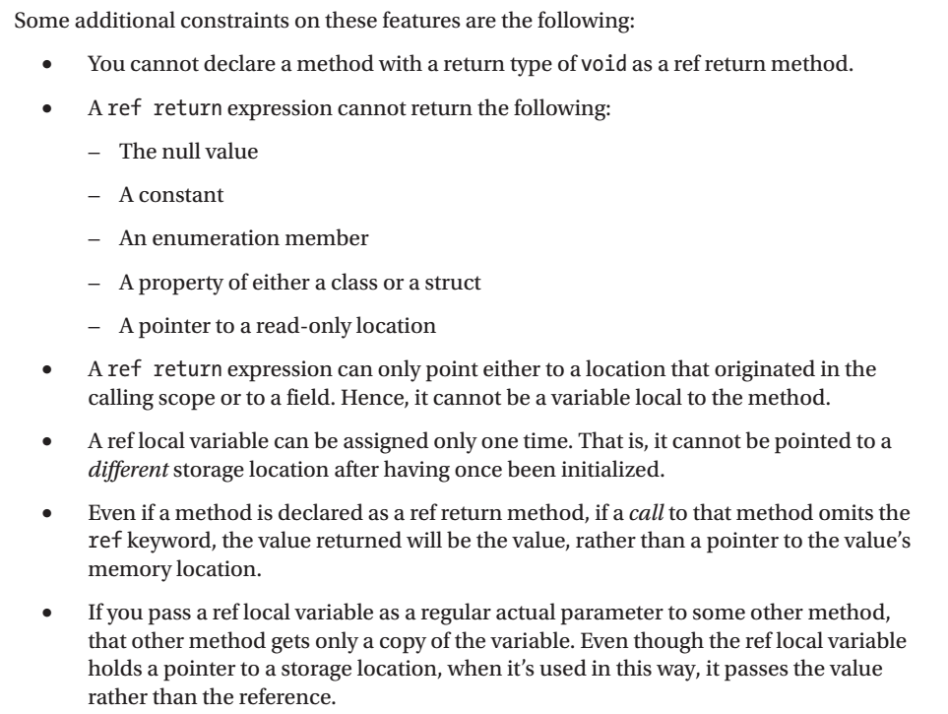

Slide 49
Method Overloading方法重载
A class can have more than one method with the same name. This is called method overloading. Each method with the same name must have a different signature than the others.

Slide 50
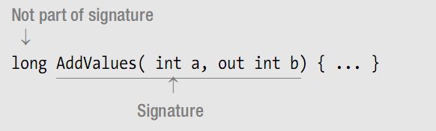
Method Signature(签名)
The return type is not part of the signature
The names of the formal parameters are also not part of the signature

Slide 51
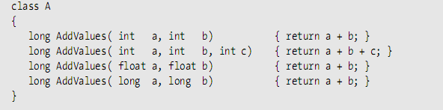
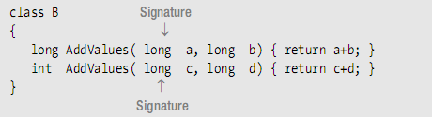
Method Signature
Right
Wrong

Slide 52
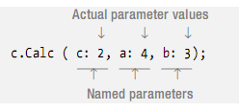

Named Parameters命名参数

Slide 53
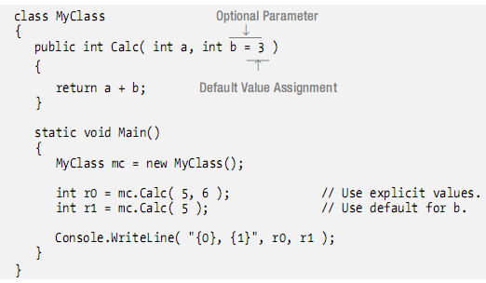
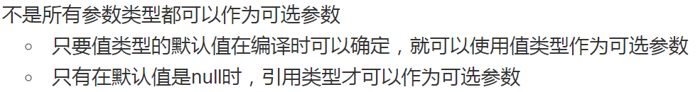
Optional Parameters可选参数
Optional parameters can only be value parameter types.

Slide 54
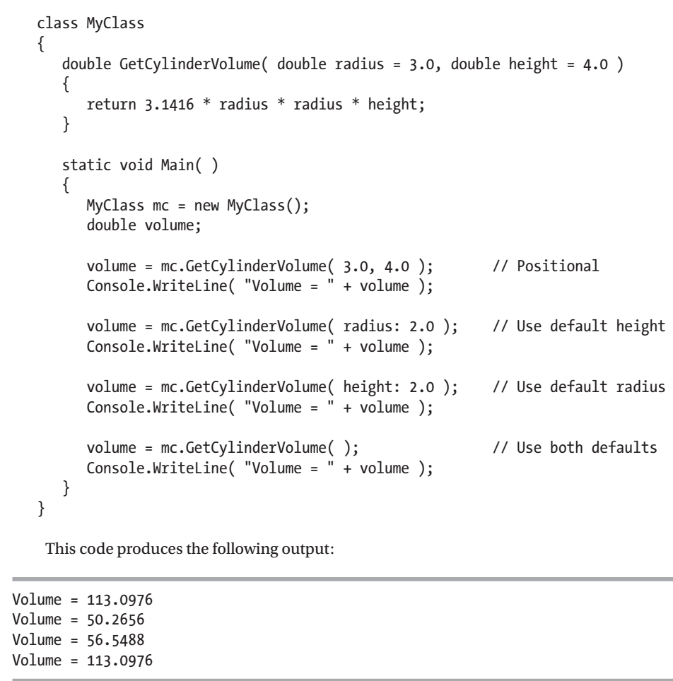

Slide 55

Stack Frames

Slide 56


终于
结束啦！

